Slide 1

CSC-321
Design and Analysis of Algorithm
Complex Engineering Problem

Slide 2
Overview
Explanation of Problem
Explanation of design approach adopted and reasoning
Algorithm Design and explanation of strategy selected
Proof of correctness
Analysis calculate time complexity
In this Presentation

Slide 3

Group Members:
Muhammad Daud Mehboob
Muhammad Zeeshan Ali
Muhammad Shoaib Akhter Qadri

Slide 4
Problem Description & Objective
Solution Approach & Output Requirements:
You are given a binary array A with elements 0 and 1 of size N. and integer K. Let's call the score of an array the difference between the maximum and minimum element within the array. For example [1, 0, 0, 1, 0, 0], the Score of this given array is 1 - 0 = 1.
Now you have to partition the array into K continuous subarrays such that the summation of the score of all the subarrays is minimum. You also have to output starting and ending points of the subarrays corresponding to the minimum score, in increasing order of starting point. If there are multiple possibilities then output the subarrays such that starting points will be lexicographically smallest.

Slide 5


Explanation of Design Approach
And Reasoning
DYNAMIC PROGRAMMING
The dynamic programming approach is a common technique used to solve optimization problems. In this case, we want to minimize the sum of the scores of the subarrays, so dynamic programming is a natural choice.
The reasoning behind this approach is that we can break down the problem into smaller subproblems and use their solutions to build the solution to the larger problem. Specifically, we can keep track of the minimum score that can be achieved by partitioning the first `i` elements of the array into `j` subarrays. This allows us to find the optimal partitioning of the entire array by considering all possible ways of partitioning it into `K` subarrays.
This approach is efficient because it avoids recomputing the same subproblems multiple times. Instead, we store their solutions in a table and reuse them when needed. This can significantly reduce the time complexity of the algorithm.
Overall, the dynamic programming approach is a powerful technique that allows us to solve this problem efficiently and effectively.

Slide 6
Algorithm Design & Explanation
1
2
3
4
5
Step
Step
Step
Step
Step
Initialize a 2D array “dp”
For loop for “I”
For loop for “j”
Initialize Result List
Backtracking and compiling
Initialize a 2D array dp of size
“N x K” with all elements set to infinity.
For i from 1 to N, set dp[i][1] to the score of the subarray from index 1 to i
For j from 2 to K, for i from j to N, iterate through all possible partition points k from j-1 to i-1, and update dp[i][j] with the minimum value of dp[k][j-1] + score(k+1, i)
Initialize a list result to store the starting and ending points of each subarray.
Backtrack from dp[N][K] to find the starting and ending points of each subarray, and add them to the list result in reverse order.
Return the list result.

Slide 7
Explanation by Example: A = [1, 0, 1, 0] & K = 2
Step 1:
Initialize a 2D array “dp” dp of size "NxK" with all elements set to infinity
In this case, N is 6 and K is 3, so dp will be a 6x3 array with all elements set to infinity.
Step 2:
For i from 1 to N, set dp[i][1] to the score of the subarray from index 1 to i.
In this case, dp[1][1] will be set to the score of the subarray [1], which is 0.
dp[2][1] will be set to the score of the subarray [1,1], which is also 0.
dp[3][1] will be set to the score of the subarray [1,1,0], which is 1.
dp[4][1] will be set to the score of the subarray [1,1,0,0], which is also 1.
dp[5][1] will be set to the score of the subarray [1,1,0,0,0], which is also 1.
And dp[6][1] will be set to the score of the subarray [1,1,0,0,0,1], which is also 1.

Slide 8
Explanation by Example: A = [1, 0, 1, 0] & K = 2
Step 3 :
For j from 2 to K, for i from j to N, iterate through all possible partition points k from j-1 to i-1 and update dp[i][j] with the minimum value of dp[k][j-1]+ score(k+1,i). In this case:
- When j is 2 and i is 2: we iterate through k from 1 to 1 and update dp[2][2] with the minimum value of dp[1][1]+score(2,2), which is min(0+0)=0.
- When i is 3: we iterate through k from 1 to 2 and update dp[3][2] with the minimum value of min(dp[1][1]+score(2,3),dp[2][1]+score(3,3)), which is min(0+0,0+0)=0.
When i is 4: we iterate through k from 1 to 3 and update dp[4][2] with the minimum value of min(dp[1][1]+score(2,4),dp[2][1]+score(3,4),dp[3][1]+score(4,4)), which is min(0+0,0+0,1+0)=0.
- When i is 5: we iterate through k from 1 to 4 and update dp[5][2] with the minimum value of min(dp[1][1]+score(2,5),dp[2][1]+score(3,5),dp[3][1]+score(4,5),dp[4][1]+score(5,5)), which is min(0+0,0+0,1+0,1+0)=0.
- When i is 6: we iterate through k from 1 to 5 and update dp[6][2] with the minimum value of min(dp[1][1]+score(2,6),dp[2][1]+score(3,6),dp[3][1]+score(4,6),dp[4][1]+score(5,6),dp[5][1]+score(6,6)), which is min(0+0,0+0,1+0,1+0,1+0)=0.

Slide 9
Explanation by Example: A = [1, 0, 1, 0] & K = 2
Step 3 :
For j from 2 to K, for i from j to N, iterate through all possible partition points k from j-1 to i-1 and update dp[i][j] with the minimum value of dp[k][j-1]+ score(k+1,i). In this case:
- When j is 3 and i is 3: we iterate through k from 2 to 2 and update dp[3][3] with the minimum value of dp[2][2]+score(3,3), which is min(0+0)=0.
- When i is 4: we iterate through k from 2 to 3 and update dp[4][3] with the minimum value of min(dp[2][2]+score(3,4),dp[3][2]+score(4,4)), which is min(0+0,0+0)=0.
- When i is 5: we iterate through k from 2 to 4 and update dp[5][3] with the minimum value of min(dp[2][2]+score(3,5),dp[3][2]+score(4,5),dp[4][2]+score(5,5)), which is min(0+0,0+0,0+0)=0.
- When i is 6: we iterate through k from 2 to 5 and update dp[6][3] with the minimum value of min(dp[2][2]+score(3,6),dp[3][2]+score(4,6),dp[4][2]+score(5,6),dp[5][2]+score(6,6)), which is min(0+0,0+0,0+0,0+0)=0.

Slide 10
Explanation by Example: A = [1, 0, 1, 0] & K = 2
Step 4 :
Initialize a list result to store the starting and ending points of each subarray.
Step 5 :
Backtrack from dp[N][K] to find the starting and ending points of each subarray and add them to the list result in reverse order.
In this case, dp[6][3] is 0. We can backtrack from it to find that one possible partition that gives us a minimum score is [1],[1],[0],[0],[0],[1]. The starting and ending points of these subarrays are (1,1),(2,2),(3,3),(4,4),(5,5),(6,6).
Step 6 :
Return the list result.
In this case, the result is [(1,1),(2,2),(3,3),(4,4),(5,5),(6,6)].

Slide 11

Proof of Correctness
The correctness of the dynamic programming algorithm can be proven using induction.
Base case: When `i = 0` and `j = 0`, we have `dp[0][0] = 0`, which is the correct value since partitioning an empty array into 0 subarrays gives a score of 0.
Inductive step: Assume that `dp[i][j]` is the correct minimum score for partitioning the first `i` elements of the array into `j` subarrays for all `i < n` and all `j <= k`. We want to show that `dp[n][k]` is also the correct minimum score for partitioning the first `n` elements of the array into `k` subarrays.
By definition, the minimum score for partitioning the first `n` elements of the array into `k` subarrays is given by the minimum score that can be achieved by partitioning the first `p` elements into `k-1` subarrays, plus the score of the subarray from `p+1` to `n`, where `p` ranges from 0 to `n-1`. This is exactly what our algorithm calculates when it updates `dp[n][k]`, so we have shown that `dp[n][k]` is indeed the correct minimum score for partitioning the first `n` elements of the array into `k` subarrays.
Therefore, by induction, we have shown that our algorithm correctly calculates the minimum score for partitioning the entire array into `K` subarrays.

Slide 12

Calculating Time Complexity
The time complexity of the dynamic programming algorithm for this problem is O(N² * K), where N is the size of the array and K is the number of subarrays.
Reasons:
Initializing the 2D array `dp` takes O(N * K) time.
The outer loop that iterates over `i` from 1 to `N` takes O(N) time.
The inner loop that iterates over `j` from 1 to `K` takes O(K) time.
The innermost loop that iterates over `p` from 0 to `i-1` takes O(N) time.
Calculating the score of the subarray from `p+1` to `i` takes O(1) time.
Updating `dp[i][j]` takes O(1) time.
Therefore, the total time complexity of the algorithm is O(N * K * N) = O(N² * K).This time complexity is reasonable for small to medium-sized inputs, but it may become a bottleneck for very large inputs. In such cases, more advanced techniques may be needed to solve the problem more efficiently.

Slide 13
Do you have
any questions?
Send it to us!
We hope you learned something new.

Slide 14

THANK YOU

Slide 15
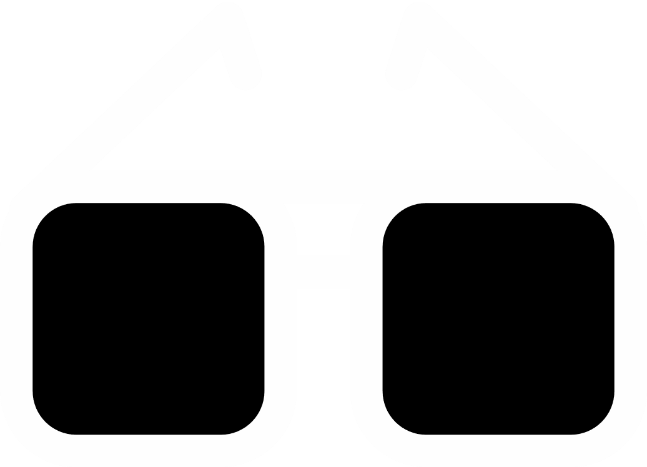



























Free Resources
Use these free recolorable icons and illustrations in
your Canva design

